Slide 1

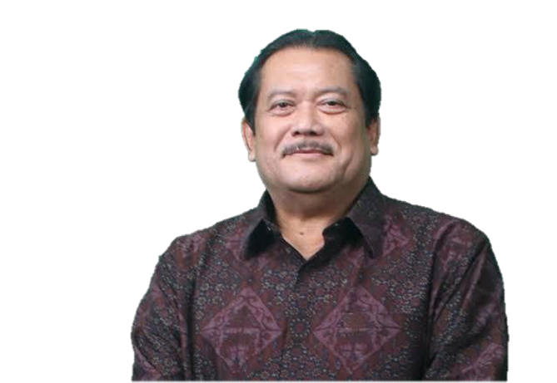
INDONESIA ICT LANDSCAPE
Opportunity and Challenges in Cyber Security
Bali, 8 November 2023
Presented by:
SARWOTO ATMOSUTARNO
CHAIRMAN OF INDONESIA TELEMATIC SOCIETY (MASTEL)
@Sarwoto Atmosutarno

Slide 2

Table of Contents
G20 Message
Indonesia Economy
Indonesia Digital Economy
Cyber Security
Conclusion

Slide 3


















G20 Message
India G20 2023 Messages:
Digital Public Infrastructures
Upskilling Digital Talents
Cybersecurity on Digital Economy
ITU CONNECT 2030 - GOALS AND TARGETS TO SDG’S
Goal 1 – Growth: Enable and foster access to and increased use of telecommunications/ICT in support of the digital economy and society
Goal 2 – Inclusiveness: Bridge the digital divide and provide broadband access for all
Goal 3 – Sustainability: Manage emerging risks, challenges and opportunities resulting from the rapid growth of telecommunications/ICT
Goal 4 – Innovation: Enable innovation in telecommunications/ICT in support of the digital transformation of society
Goal 5 – Partnership: Strengthen cooperation among the ITU membership and all other stakeholders in support of all ITU strategic goals
Source: https://www.itu.int/en/mediacentre/backgrounders/Pages/connect-2030-agenda.aspx

Slide 4

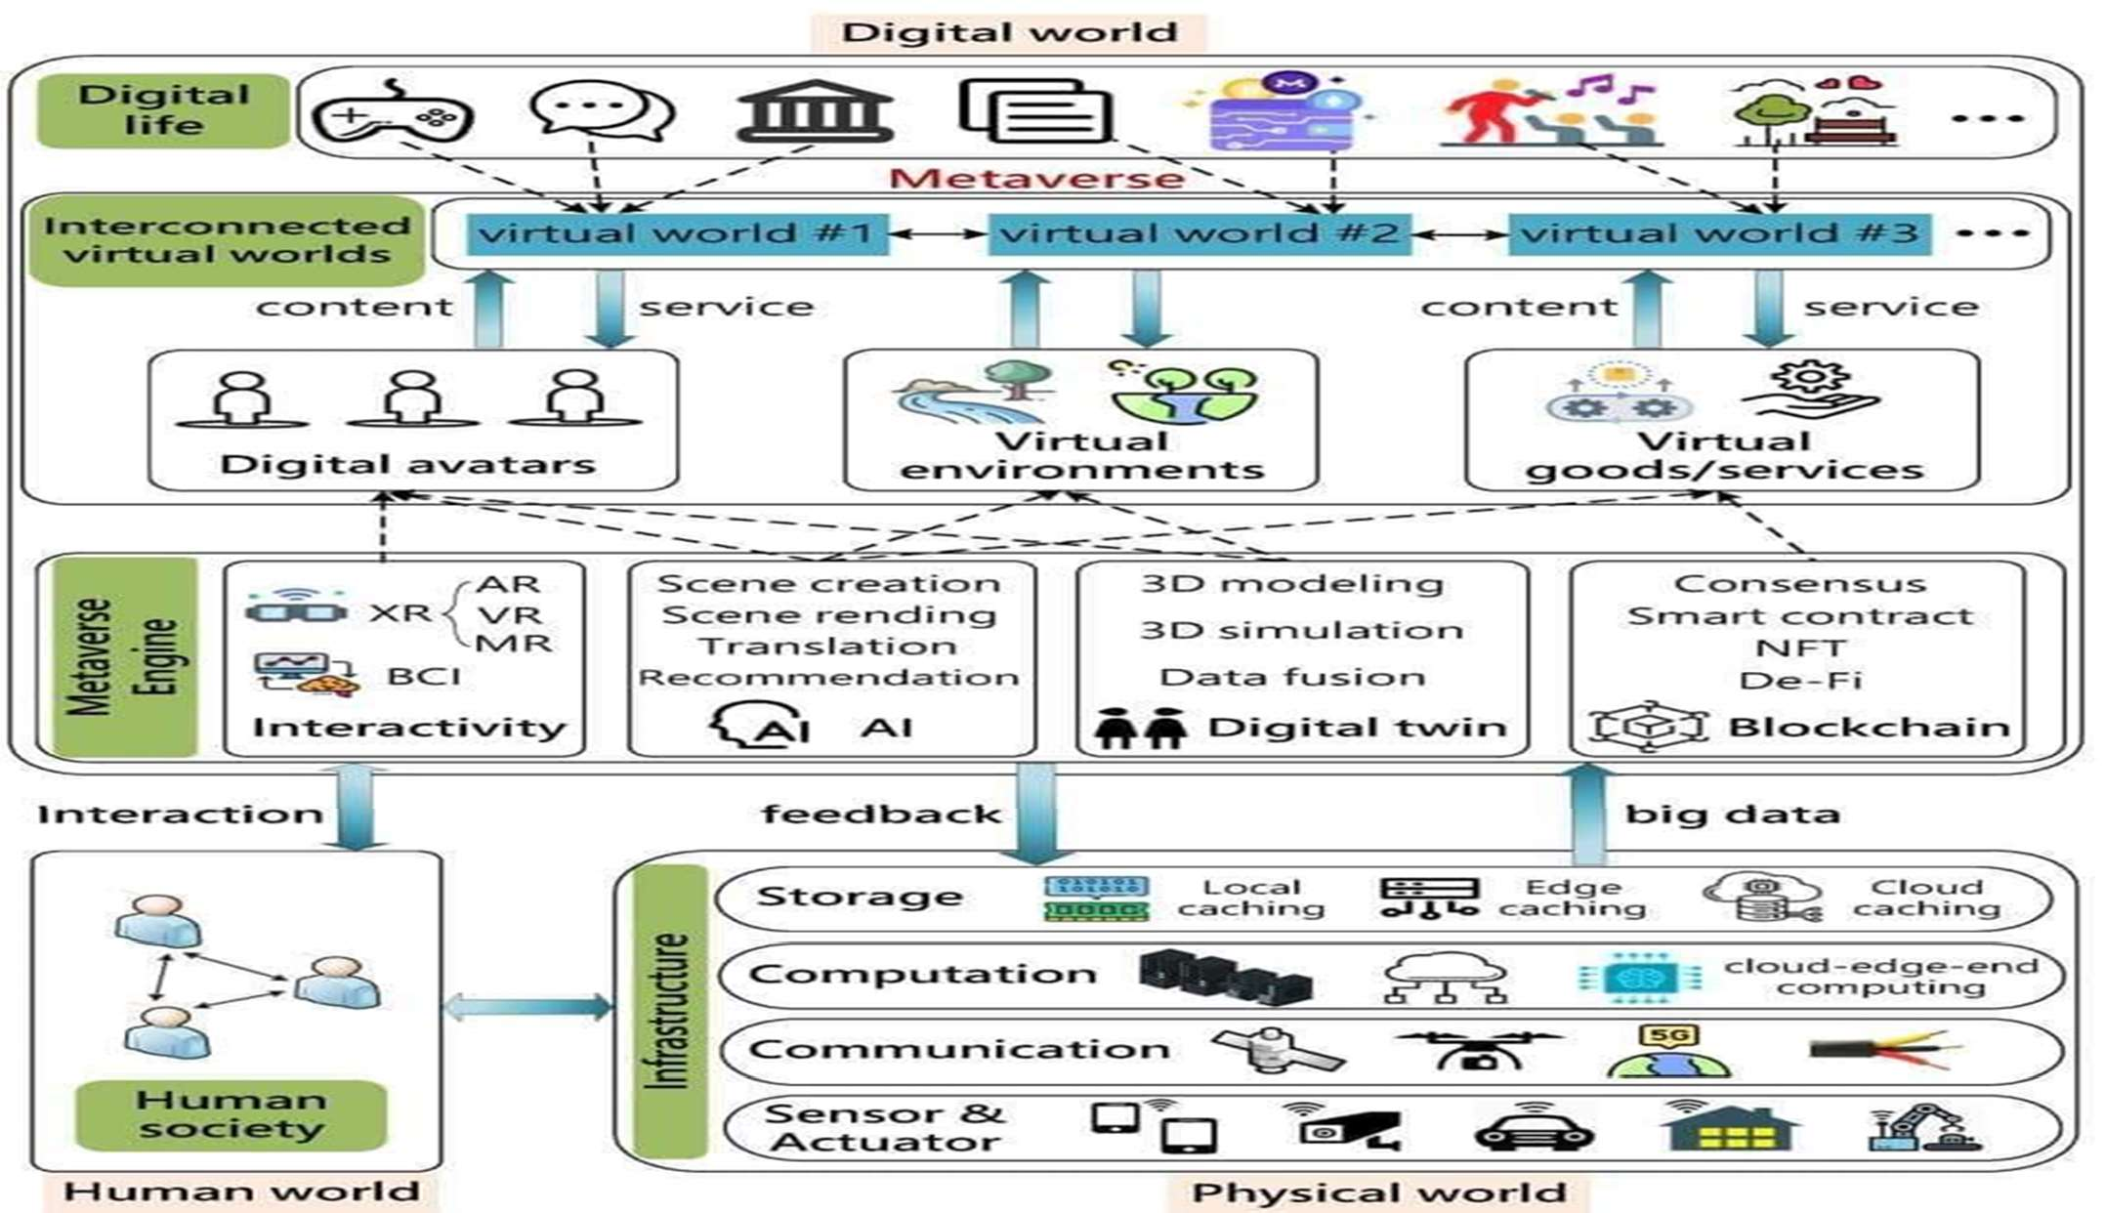
G20 Message
DIGITAL FRAMEWORK:
Interaction between (Human world-Phisycal world – Digital world) → building Trust → Investment and economic Issues to support
Sustainable Development Goals (SDGs)
Safe, inclusive and scalable digital solutions
G20’s Commitment in Technology:
Pursuing a pro-innovation regulatory approach that maximises the benefits and takes into account the risks associated with the use
of artificial intelligence
Improving access to digital services and digital public infrastructure
Building a safe, secure and resilient digital
economy
Monitoring the risks of the crypto- asset ecosystem developments
Fostering safe and resilient digital ecosystems
Source: https://www.consilium.europa.eu/en/meetings/international-summit/2023/09/09-10/

Slide 5
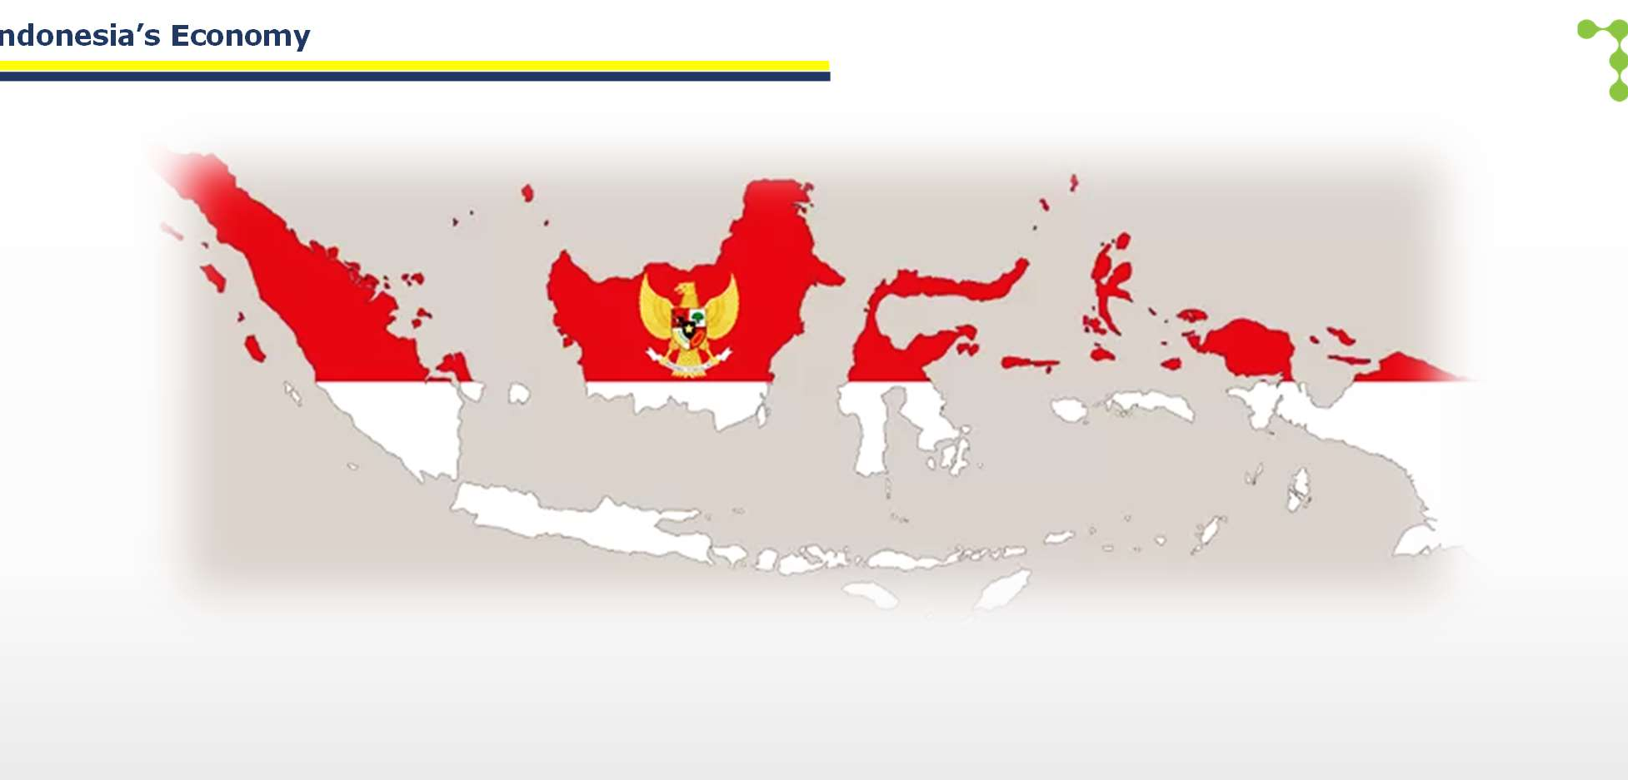


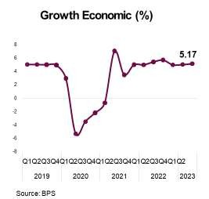
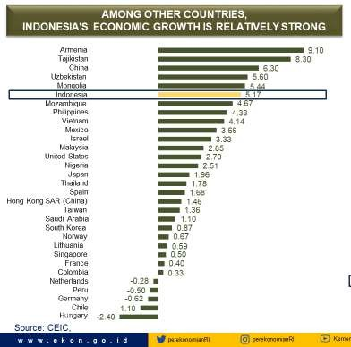
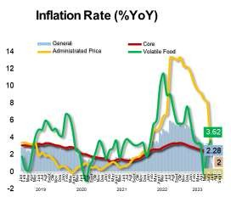
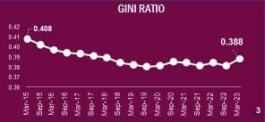
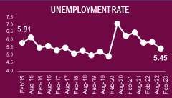
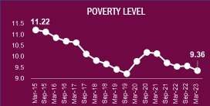
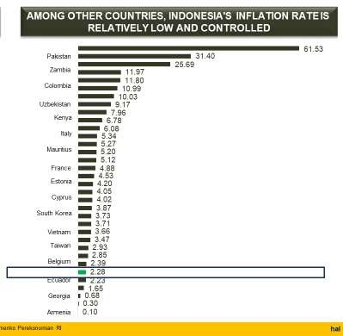
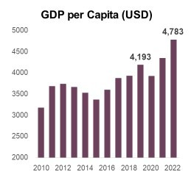
I
ndonesia’s Economy
Indonesia Economic Position in March 23: strong, solid and controllable
Growth Economic 5.17%, GDP per Capita 4,783 USD and Inflation Rate in 2.28% YoY
Poverty Level 9.36, Unemployment Rate 5.45 and GINI Rate 0.388
Among other countries, Indonesia Economic Growth is relatively strong in the position 5.17
Among other countries, Indonesia’s Inflation Rate is relatively low and controlled in the level 2.28

Slide 6

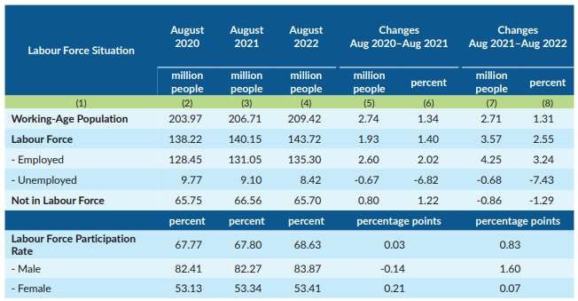
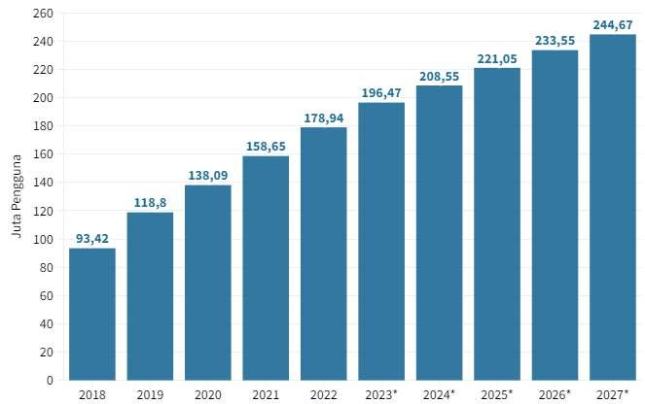
Indonesia’s Digital Economy
E-commerce projection user in 2018 - 2027
Working-Age Population and Labour Force, August 2020–August 2022
https://dataindonesia.id/ekonomi-digital/detail/pengguna-ecommerce-ri-diproyeksi-capai-19647-juta-pada-2023
https://www.bps.go.id/pressrelease/2022/11/07/1916/agustus-2022--tingkat-pengangguran-terbuka--tpt--sebesar-5-86- persen-dan-rata-rata-upah-buruh-sebesar-3-07-juta-rupiah-per-bulan.html
E-commerce in Indonesia is predicted 244,67 million in 2027, meanwhile, Bank Indonesia (BI) noted that the value of e-commerce transactions in Indonesia will be IDR 476.3 trillion in 2022 ( increased 18.8% higher than the previous year, IDR 401 trillion)
Working age population grows 1.31% from 2021 to 2023 with the increasing of appx three million people. Meanwhile, the employed labour force is also develop 3.24% from 2021 to 2022 with 4.25 million addition, on the contrary, unemployed labour force down to 7.43% with the decreasing 0.68 million people. Furtheremore, female labour force participant rate is less then male participant (0.07% to 1.60%) in 2022.

Slide 7








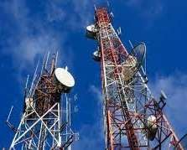

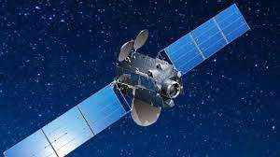
Indonesia’s Digital Economy
Success factors
Excellent human resource readiness
Increasing inclusive community literacy
Education and training policies on vocations to accelerate HR investment
Digital Talent
Sustainable Policies
DIGITAL ECONOMY
Infrastructure Readiness
Digital Literate
Development of digital connectivity facilities and infrastructure (BTS Towers, Fiber Optic Networks, Data Centers, Satellites (Multifunctional and Low Orbital Satellites)
Cyber Creation Program, Digital Talent Scholarship, and Digital Leadership
Academy, as well as Pre-Employment Car
ds
https://www.ekon.go.id/publikasi/detail/4788/optimalisasi-potensi-ekonomi-digital-pemerintah-siapkan-talenta-digital-yang-kompetitif-dan-berdaya-saing

Slide 8
1. On DIGITAL PUBLIC INFRASTRUCTURE : Network
Connectivity, Data Center and Clouds, Apps and platform, devices;
Indonesia’s Digital Economy
Digital Economy Readiness
2. On UPSKILLING DIGITAL TALENTS : Link and
match, Training, Certification and vocation,
Research and Development, Innovations;
3. On CYBER SECURITY in the DIGITAL ECONOMY :
exchange Expertise, policy benchmark, Cyber Security applications
https://www.ekon.go.id/publikasi/detail/4788/optimalisasi-potensi-ekonomi-digital-pemerintah-siapkan-talenta-digital-yang-kompetitif-dan-berdaya-saing

Slide 9

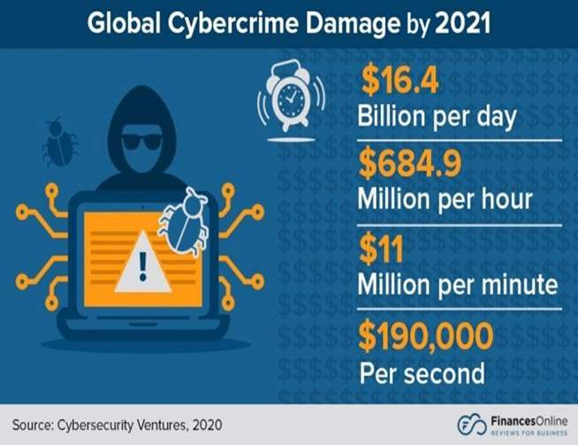
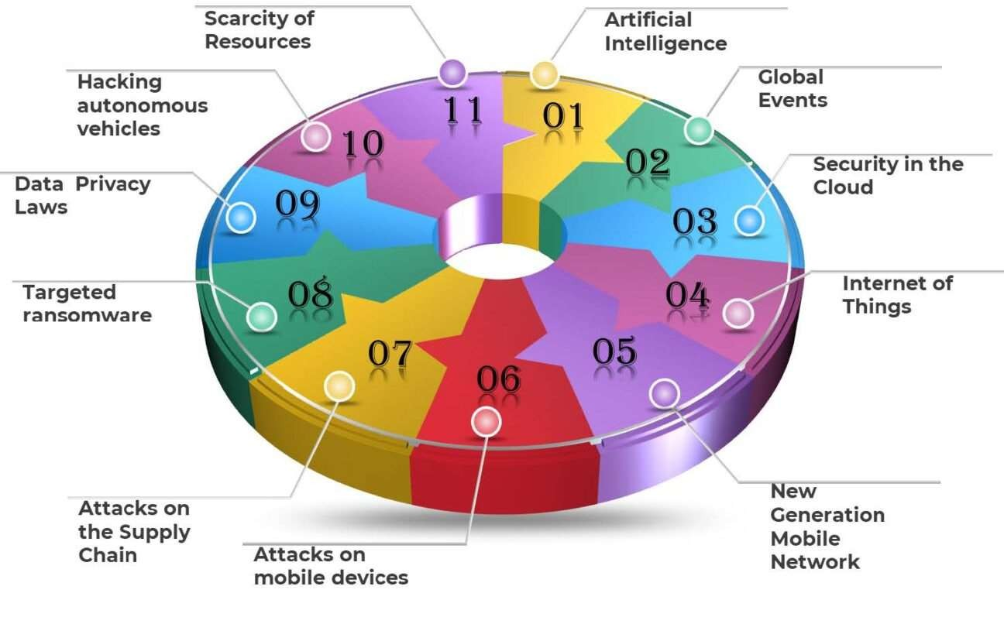

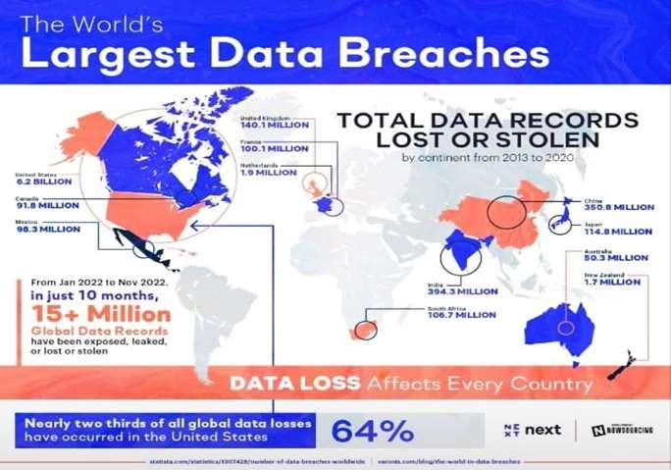
Cyber Security
System
Cyber Security
Program Apps
Network
Cyber Crime Trends 2023:
Artificial Intelligence
Global Events
Cloud Security
Internet of Things (IoT)
New Generation Mobile Network
Attacks on Mobile Devices
Attacks on Supply Chain
Targeted Ransomware
Data Privacy Law
Cyber Crime Trends 2022:
Supply chain attacks
Internet of Things (IoT) devices
The human element
Cyber crime on social media
Hacking Autonomous Vehicles
Security of Resources
https://www.devoteam.com/expert-view/11-cybersecurity-trends-for-2023/
9

Slide 10

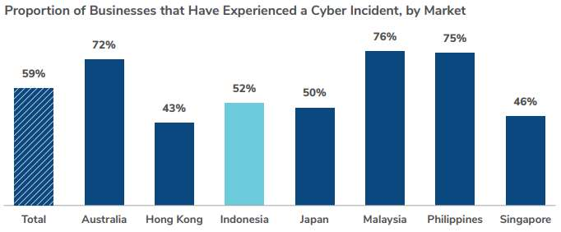
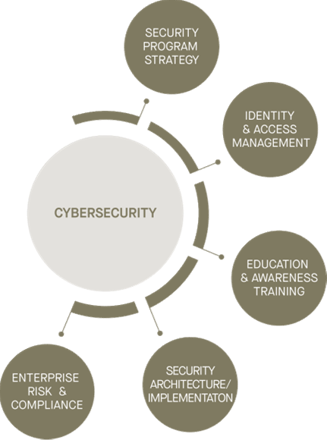
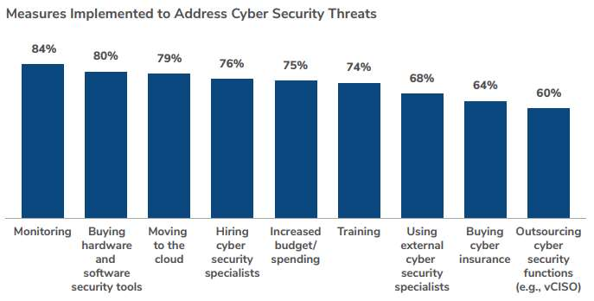
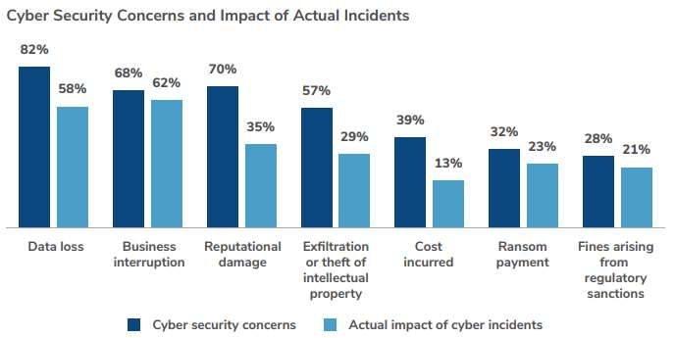
Cyber Security
Indonesia has suffered 52% in cyber incident in 2022
The biggest measures implemented to address Cyber Security Threats is through Monitoring (84%)
The highest Cyber security concerns is related to Data Loss (82%), while Actual impact of cyber incidents is in Business Interruption (62%)
https://www.kroll.com/-/media/kroll/pdfs/publications/apac-state-of-incident-response-2022.pdf, https://www.richter.ca/business-advisory/cybersecurity/
10

Slide 11
Conclusion
Digital and digitalized system are enabler to all sectors grown up
Cyber Security is important issue to solve
Digital world changing faster : internet, data Ctr/Clouds, application
Digital eco system also
Indonesia still have challenges
expanding : from telcos to webco to Techco and also GovTech (E-Government)
to maximizing Digital Spillover since we are in the stage of digital low investment and poor strategic actions
platforms, innovation on 4G/5G/6G, HTSattelites, LEO/GEO, IOT, AI, Bigdata, Blockchain, Quantumm, New Devices, new application and platforms
Studies show: Many countries growth rate depend on the level of digitalized nations and the growth their digital economy. (Indonesia to day BPS report mid 2023, the portion of Infocomm sector is still around 4,5% of GDP, we need this sector growth from around 8% (to day mid 2023) double to be around 15% growth so Infocomm sector portion to GDP reaching 10-11%. meanwhile Gross Mechandise Value(GMV) E-Commerce expected growth k.l. 35%. According to ASEAN Digital Economic Framework Agreement (DEFA), ASEAN digital economy expected growth to USD 2Trillions on 2030, from USD 1 Trillions business as usual on 2025)
11

Slide 12




THANK YOU
SARWOTO ATMOSUTARNO
Special Adviser to Minister of Information and Communications Republic Of Indonesia
sarwoto@mastel.id

